Slide 1

ONLINE EXAMINATION PORTAL
PLANET EXAMINATIONS.COM
“know and grow”
Presented by TiiT & SmiT (B.C.A):-
Rishav Shah (14501217030).
Argha Mondal (14501217052).
Ankita Dey (14501217054).
Pratima Ray (32001217012).
Avilash Jha (32001217012).
Santosh Chourasia (32001217007).

Slide 2

Acknowledgement :-
We would like to take this opportunity to express our special thanks of gratitude to our project mentor, prof. ARINDAM ROY for his constant guidance and support in completing this project. (Techno India ) for providing us a platform. We are also thankful to ANUP SIR, SUBHARANJAN SIR AND all the other faculty members for their fruitful advice ,support, attention and time , special thanks to all our group members for guidance, supervision and constant support for completing such a wonderful task.

Slide 3

Scope of the project:-
Due to recent pandemic of COVID 19 all schools and collage are closed. As it was year ending examination time and organisations cannot conduct Physical exams. This is an alternative to the physical examinations, an online examination
portal. The students after giving the test can see the scores and the answers which will help them improve their knowledge and weak areas. An online portal where users with unique id and password can login to the website and select desired examination to appear. There will be specified for giving the answers. Users can also see there past performances.
“KNOW AND GROW WITH PLANET EXAMINATION”..........

Slide 4

Software requirement specification:-
Xampp :- The xampp web server is used for the testing and running the project.
Operating System :- windows 7 and 10 is used as the operating system as it is stable and user friendly.
Sublime text:- Sublime text editor make it easy for working with code base.
CSS3.
Php.
BOOTSTRAP.
JAVASCRIPT.
CodeIgniter-MVC Framework.
HTML5.
Mysql.

Slide 5
Software running environment:-
Operating system :
=> windows 7 onwards .
=> Linux(workstation).
Browser specification:
=> internet explorer 8 onwards.
=> google crome .
=> firefox.
*all the browsers need to be compatible with HTML5.

Slide 6

COCOMO
CALCULATIONS:-
Mode | A | b | C | d
Organic | 2.4 | 1.05 | 2.5 | 0.38
Semi-detached | 3.0 | 1.12 | 2.5 | 0.35
Embedded | 3.6 | 1.20 | 2.5 | 0.32
Basic model equation:
Effort=a(KLOC) ^{b}
T_{dev.}= c(effort) ^{d}
Considering it to be of Organic Type:
KLOC=1.1
Effort=2.4(1.1)^{1.05} =2.65
T_{dev=} 2.5(2.65)^{0.38} =3.62 months
=4months (approx).

Slide 7

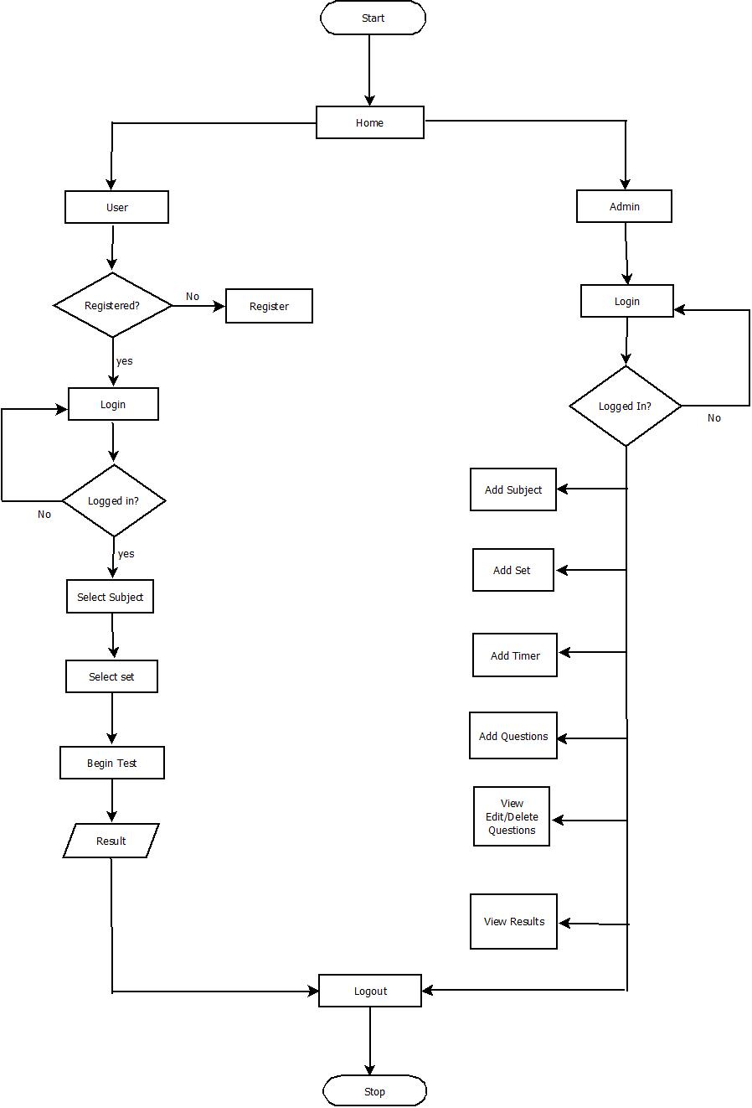
FLOW CHART: a flow chart is a type of diagram that represents a workflow or process of a particular algoritam.
.

Slide 8

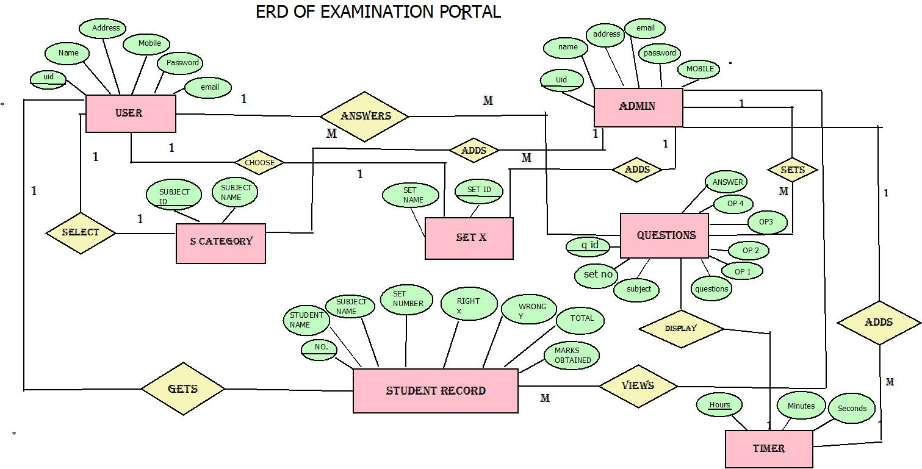
Designing solution :-
Er diagram:
An entity relationship diagram is a data modelling technique that graphically illustrates an information systems entities and the relationship between those entities.........

Slide 9
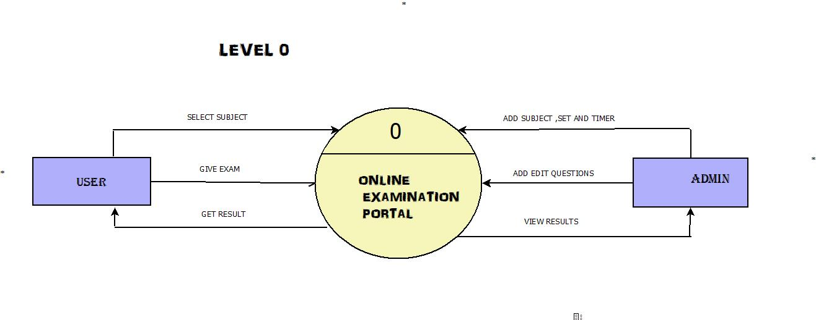
Designing solution:-
data flow diagram:
A dfd is away of representing a flow of a data of a process or a system.dfd also provides information about the outputs and inputs of each entity and the process itself
Level 0:-

Slide 10
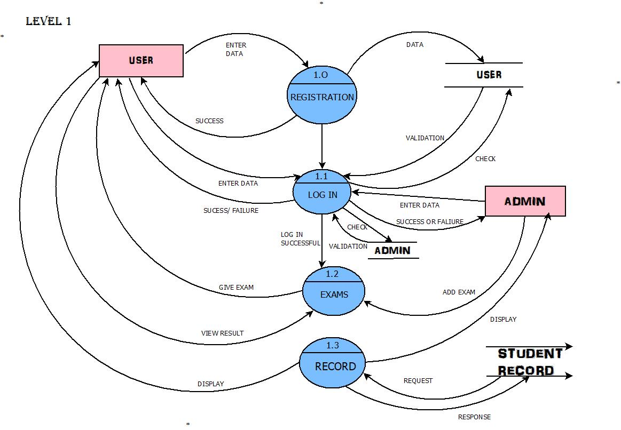
DATA FLOW DIAGRAM
LEVEL 1

Slide 11
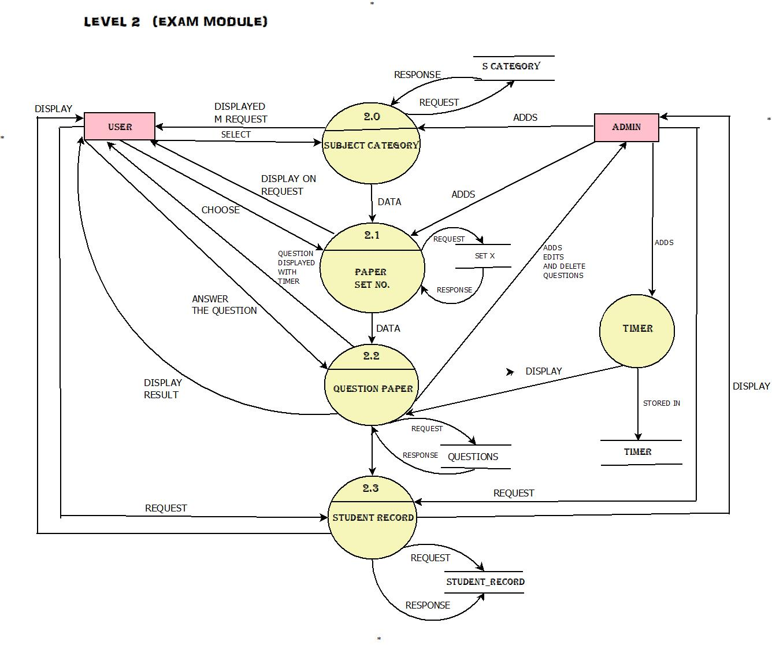
DATA FLOW DIAGRAM:-
LEVEL 2

Slide 12


SNAP SHOTS
AREA OF THE PROJECT.....

Slide 13
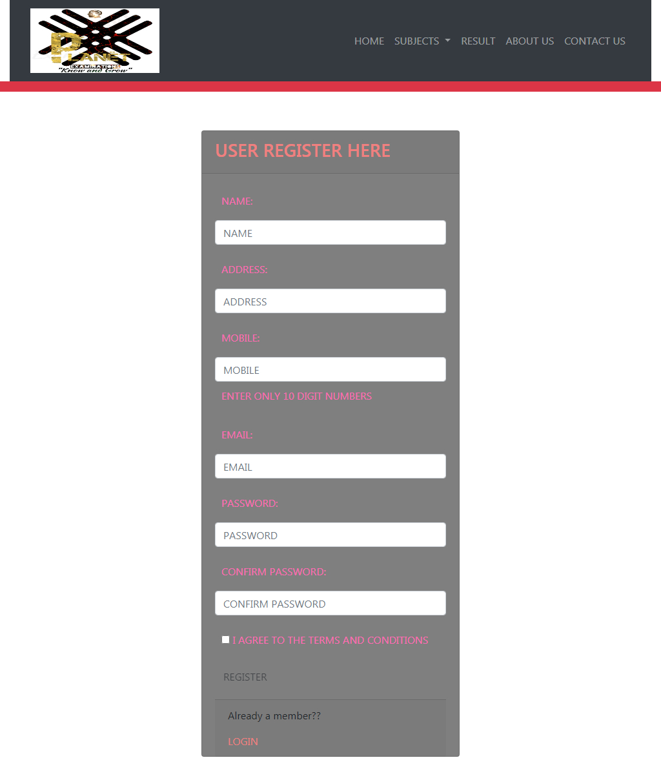
Area Of The Project(USER)
REGISTRATION PAGE:

Slide 14
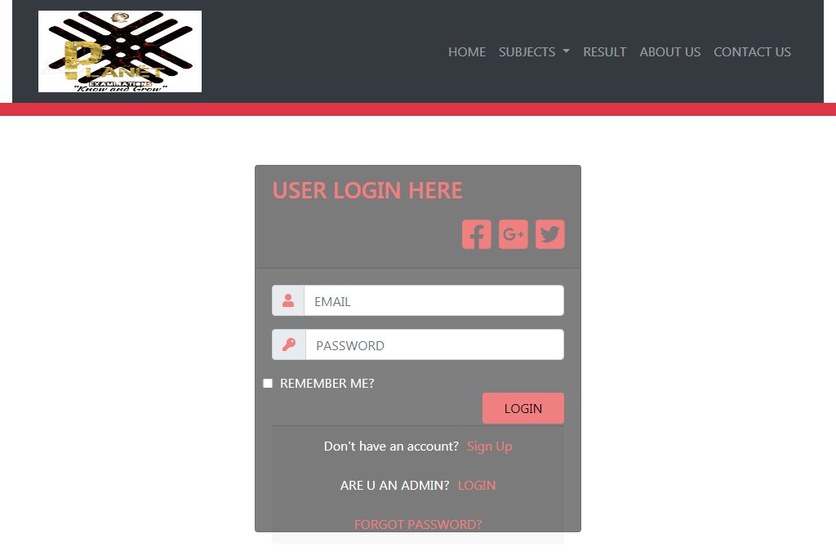
AREA OF THE PROJECT(USER)
USER LOG IN:

Slide 15
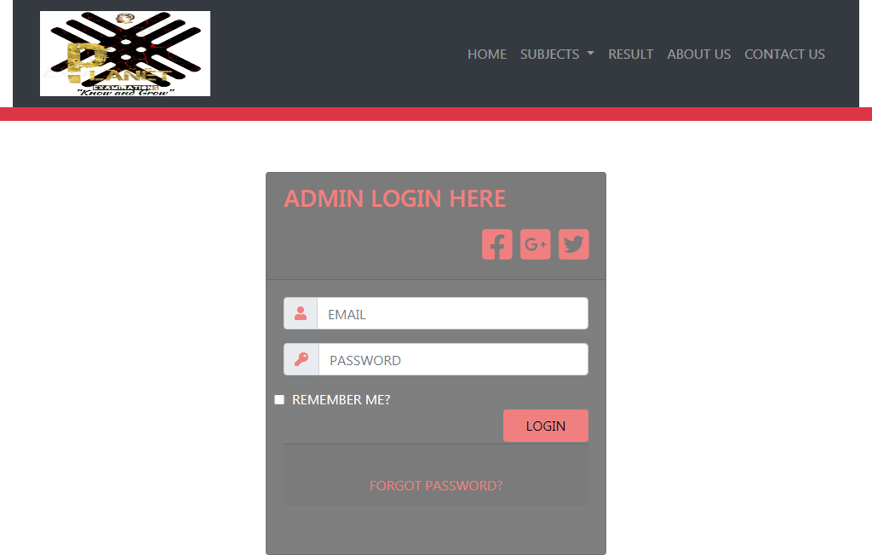
AREA OF THE PROJECT(ADMIN)
ADMIN LOG IN:-

Slide 16
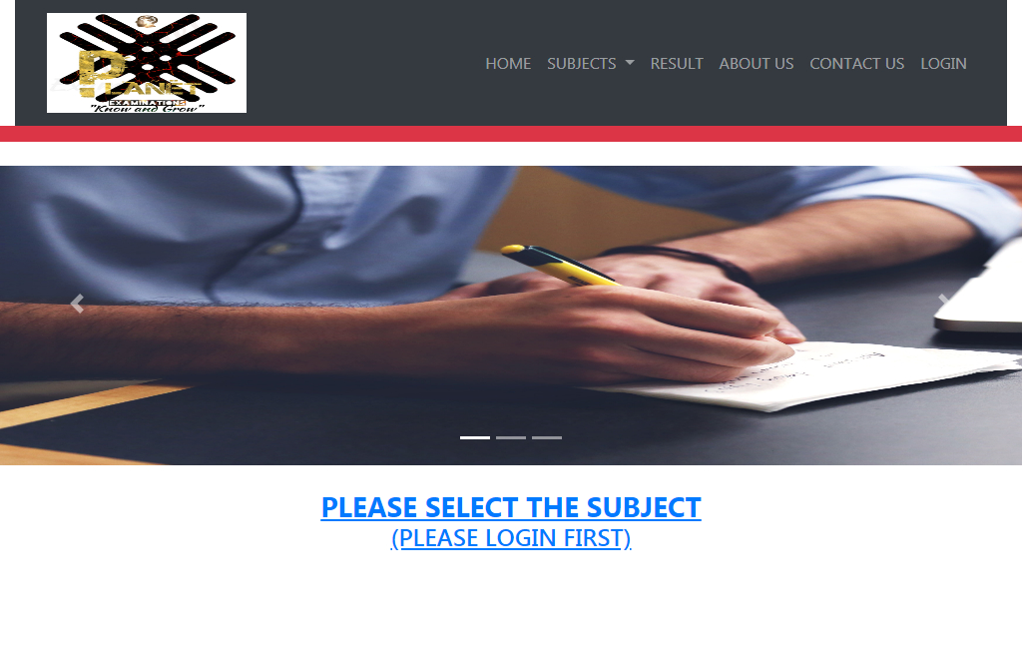
AREA OF THE PROJECT(USER)
HOME PAGE BEFORE LOGIN:-

Slide 17
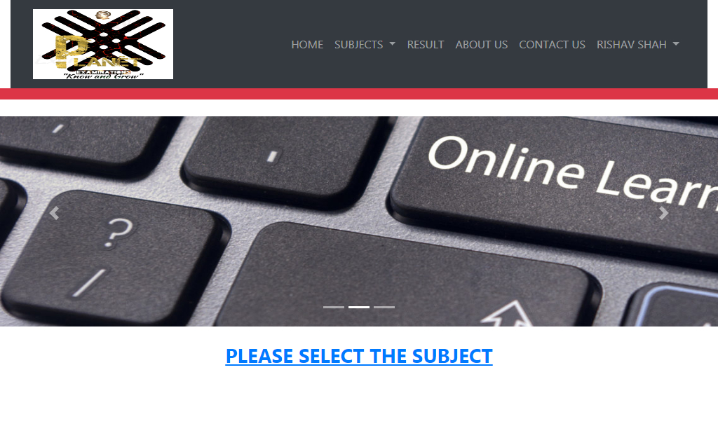
AREA OF THE PROJECT(USER)
HOME PAGE AFTER LOG IN:

Slide 18

AREA OF THE PROJECT(USER)
ABOUT US:-

Slide 19
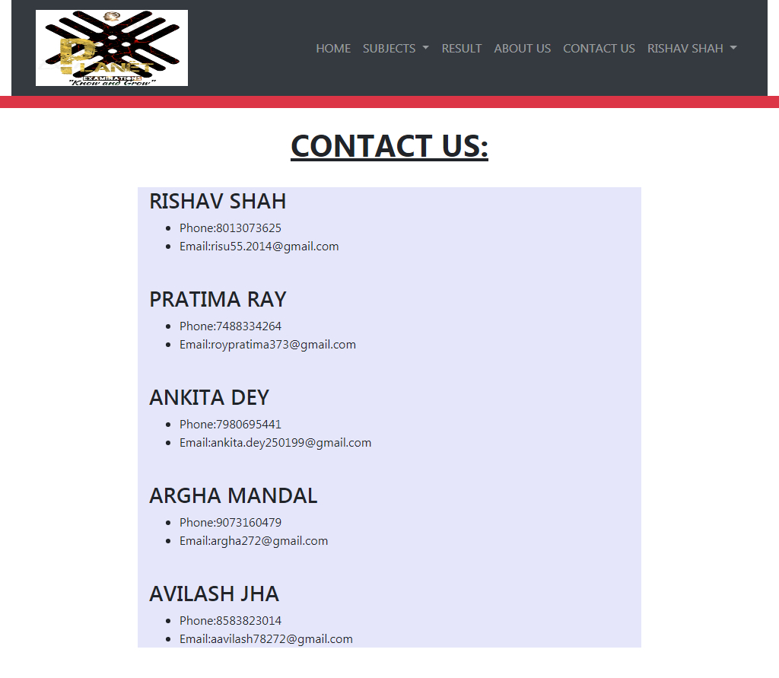
Area of the project(USER)
Contact us:-

Slide 20
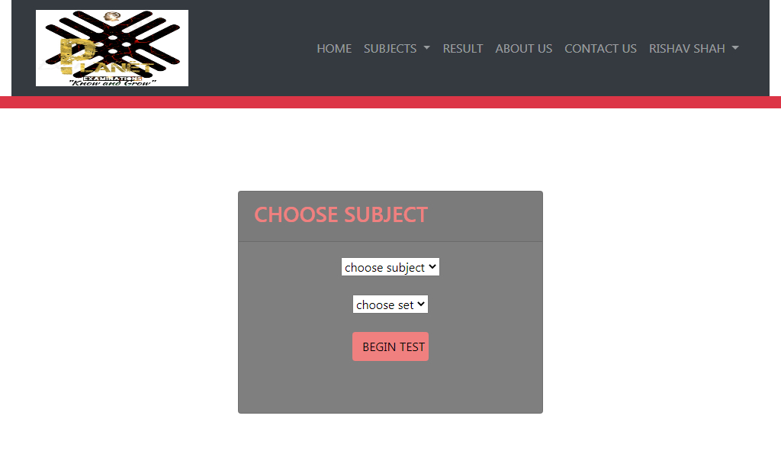
Area of the project(USER)
Selection of the test:

Slide 21
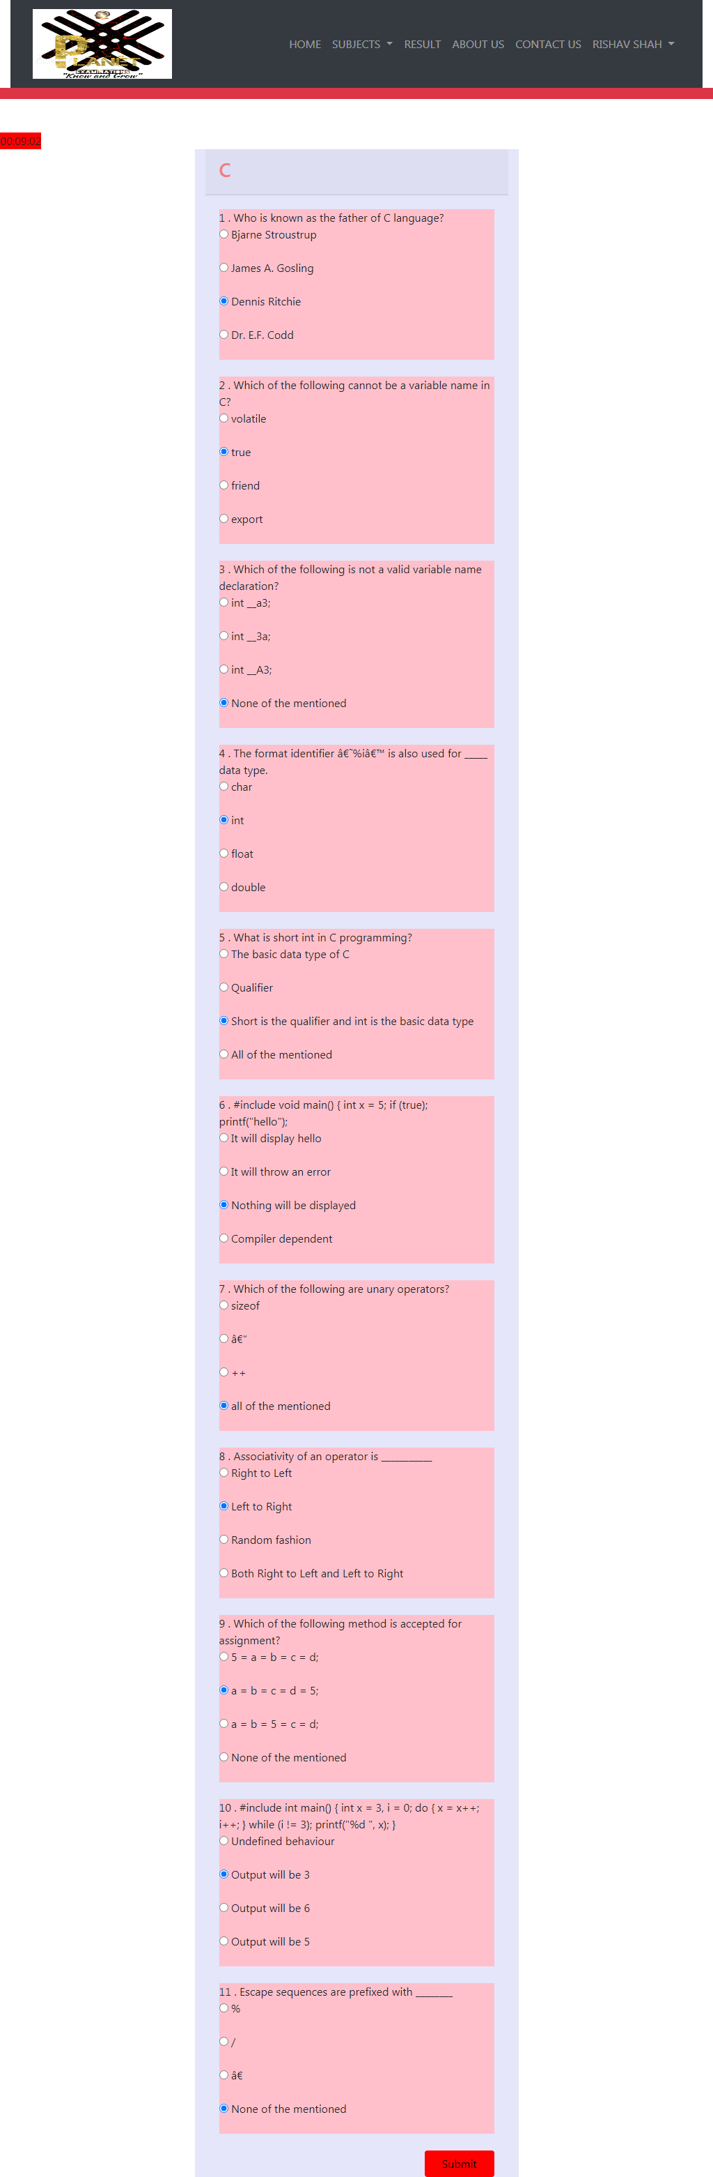
AREA OF THE PROJECT(USER)
QUESTIONS:

Slide 22
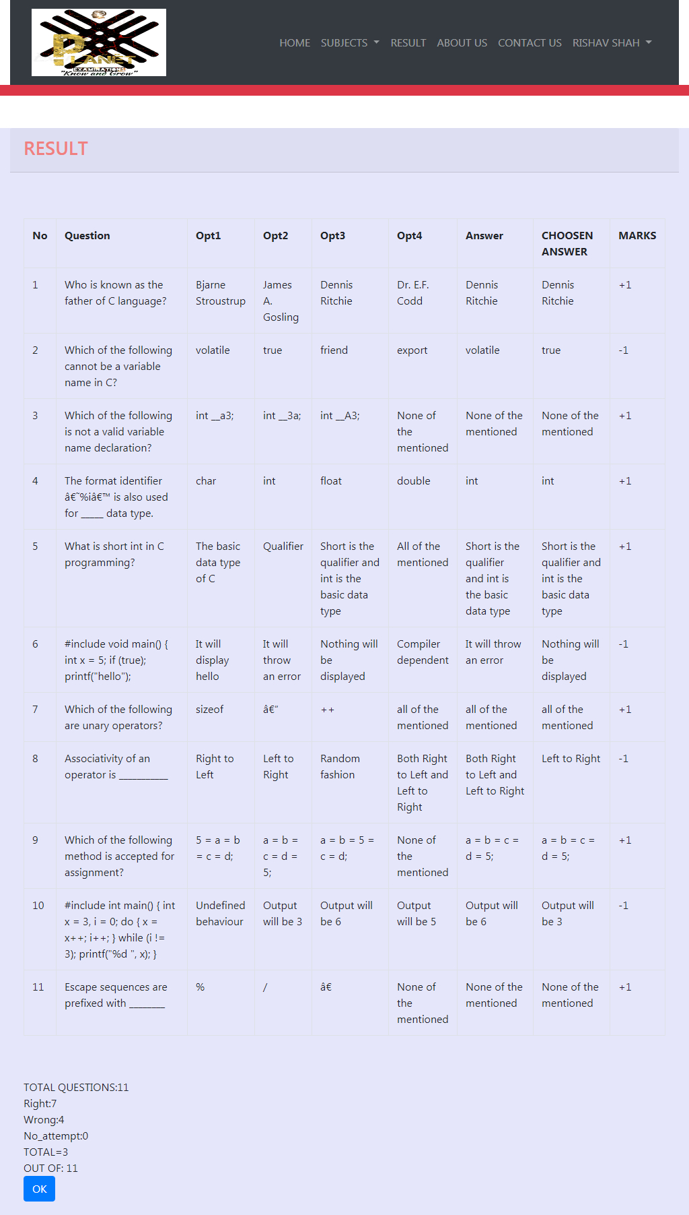
AREA OF THE PROJECT(USER)
RESULT:

Slide 23
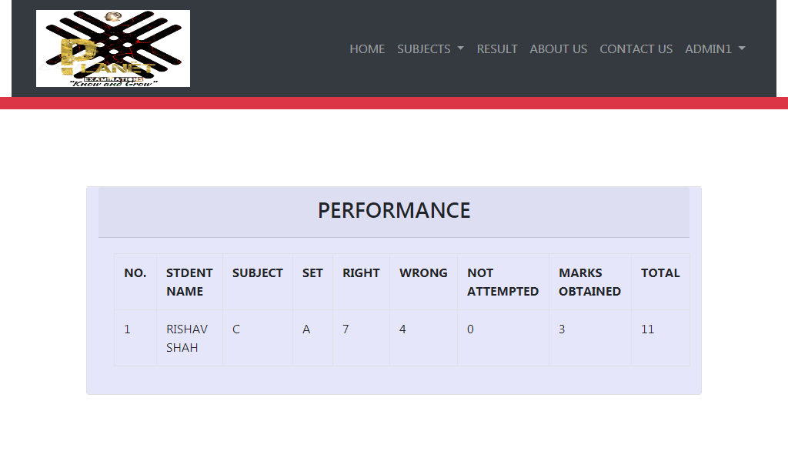
AREA OF THE PROJECT(USER)
RESULT PERFORMANCE:

Slide 24
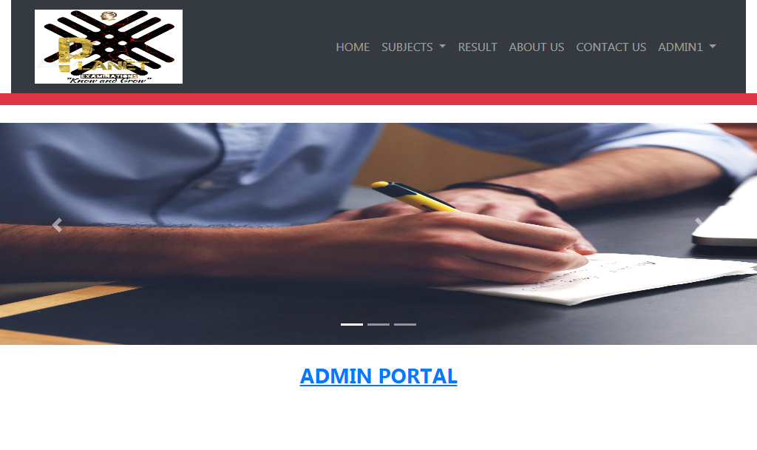
AREA OF THE PROJECT (ADMIN)
ADMIN PORTAL:-

Slide 25
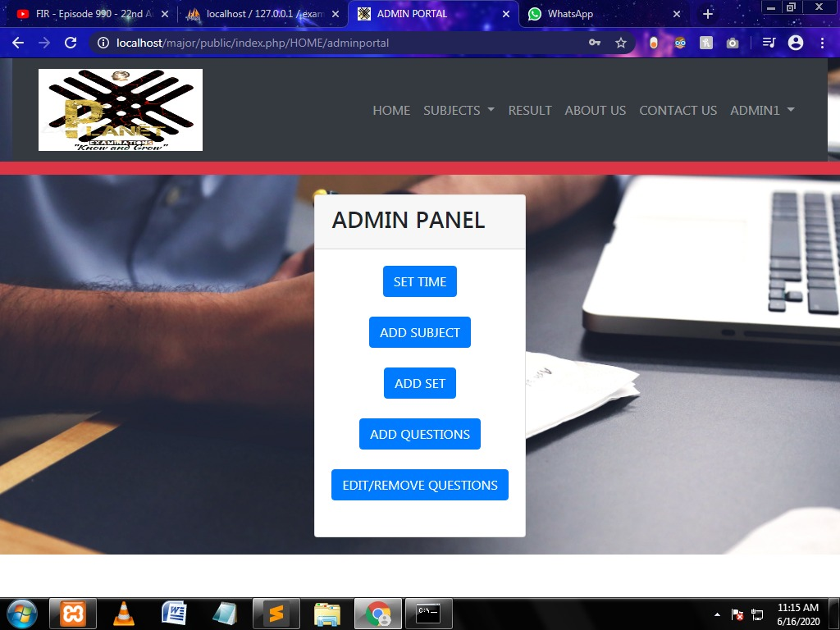
AREA OF THE PROJECT (ADMIN)
ADMIN PANEL TO ADD/EDIT/REMOVE :-

Slide 26
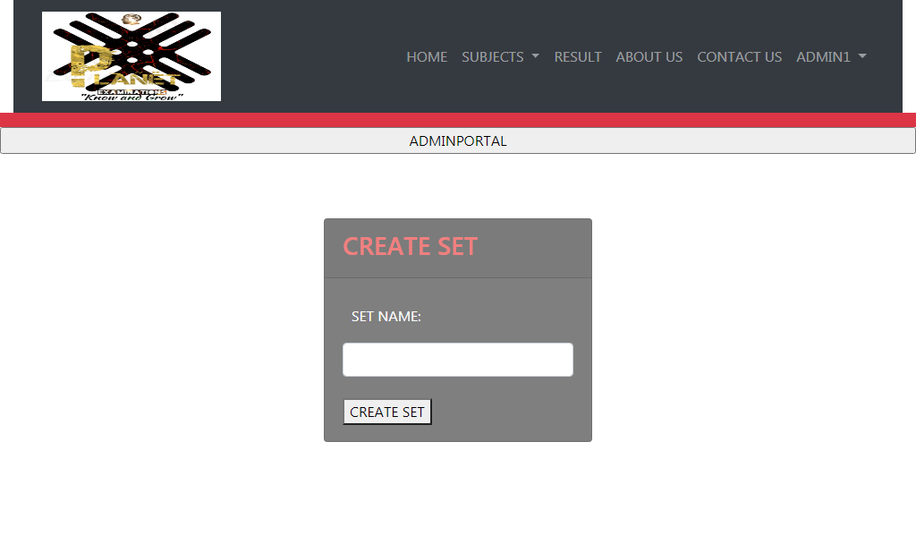
AREA OF THE PROJECT (ADMIN)
CREATE SET FOR EXAM:-

Slide 27
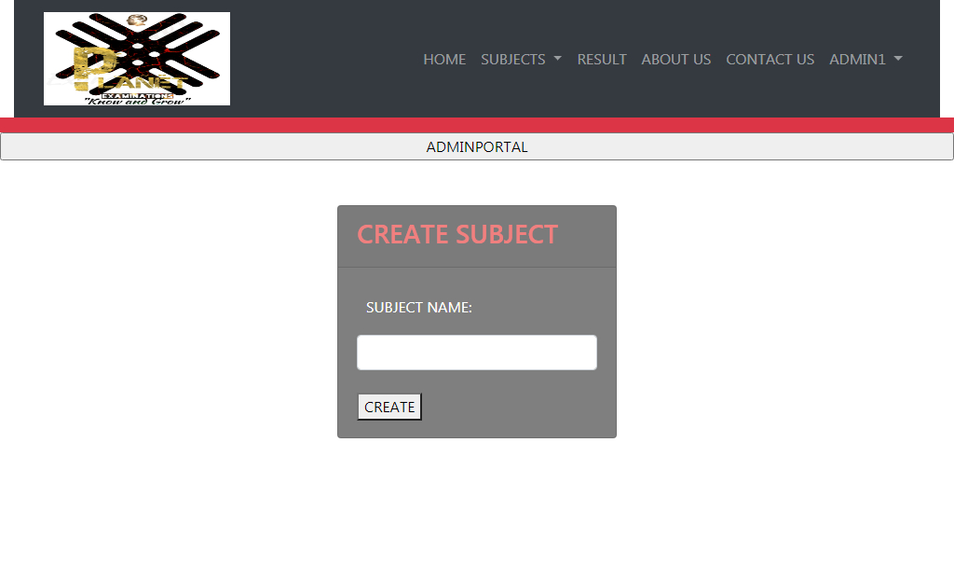
AREA OF THE PROJECT (ADMIN)
CREATE SUBJECT FOR ONLINE EXAM:-

Slide 28
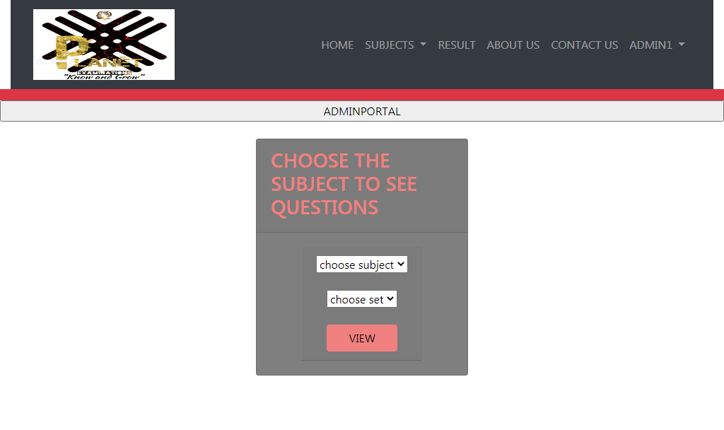
AREA OF THE PROJECT (ADMIN)
CHOOSE THE SUBJECT TO SEE QUESTIONS:-

Slide 29
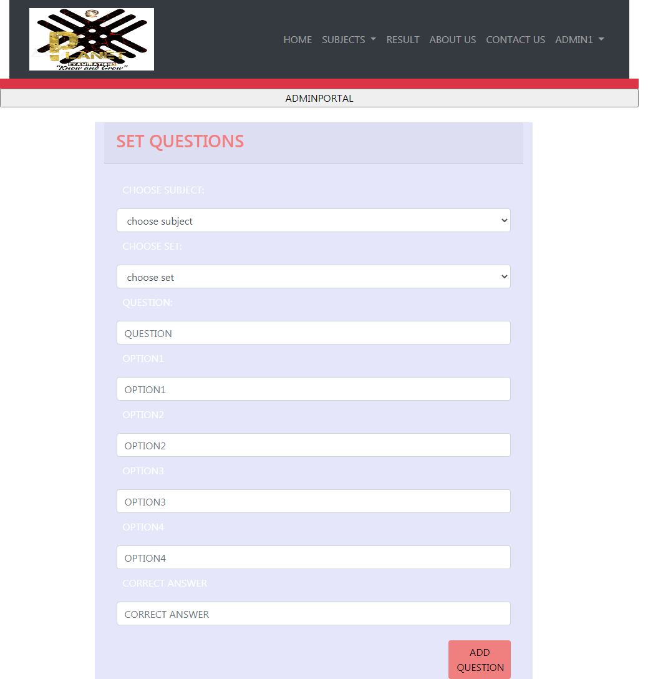
AREA OF THE PROJECT (ADMIN)
SET QUESTIONS AND MCQS:-

Slide 30
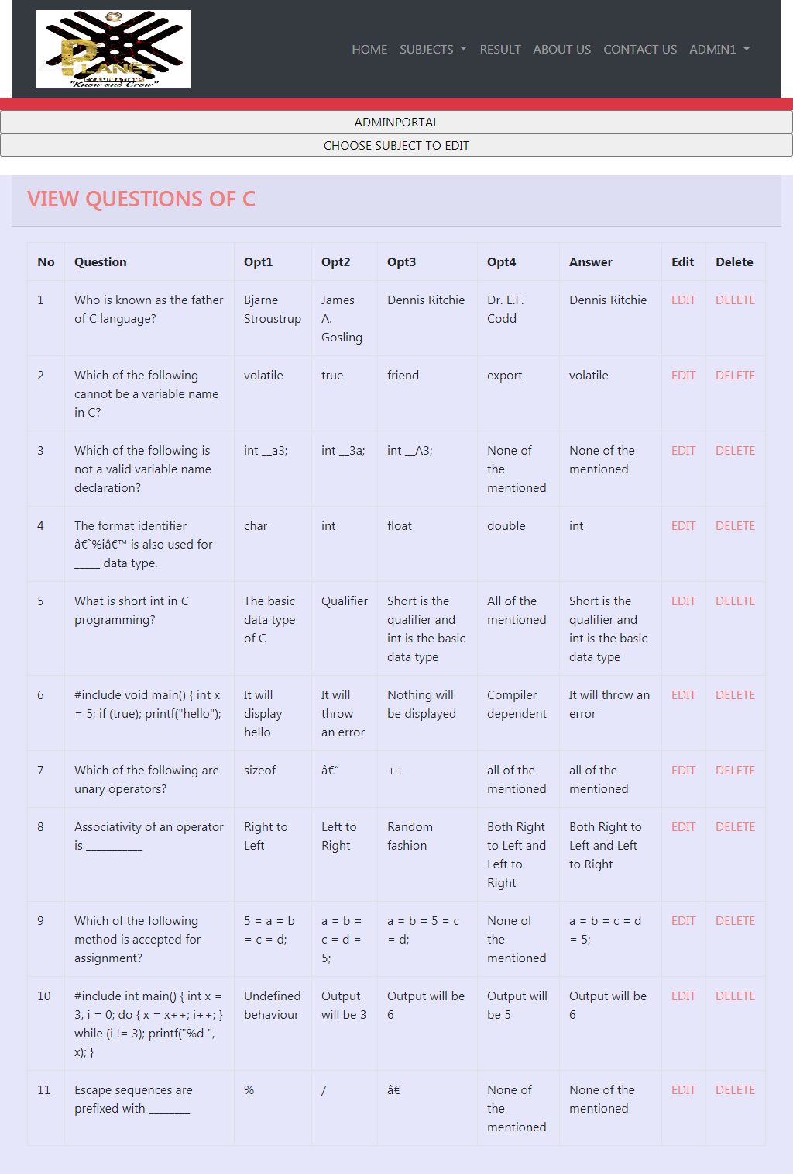
AREA OF THE PROJECT (ADMIN)
VIEW QUESTIONS AFTER ADDING:-

Slide 31

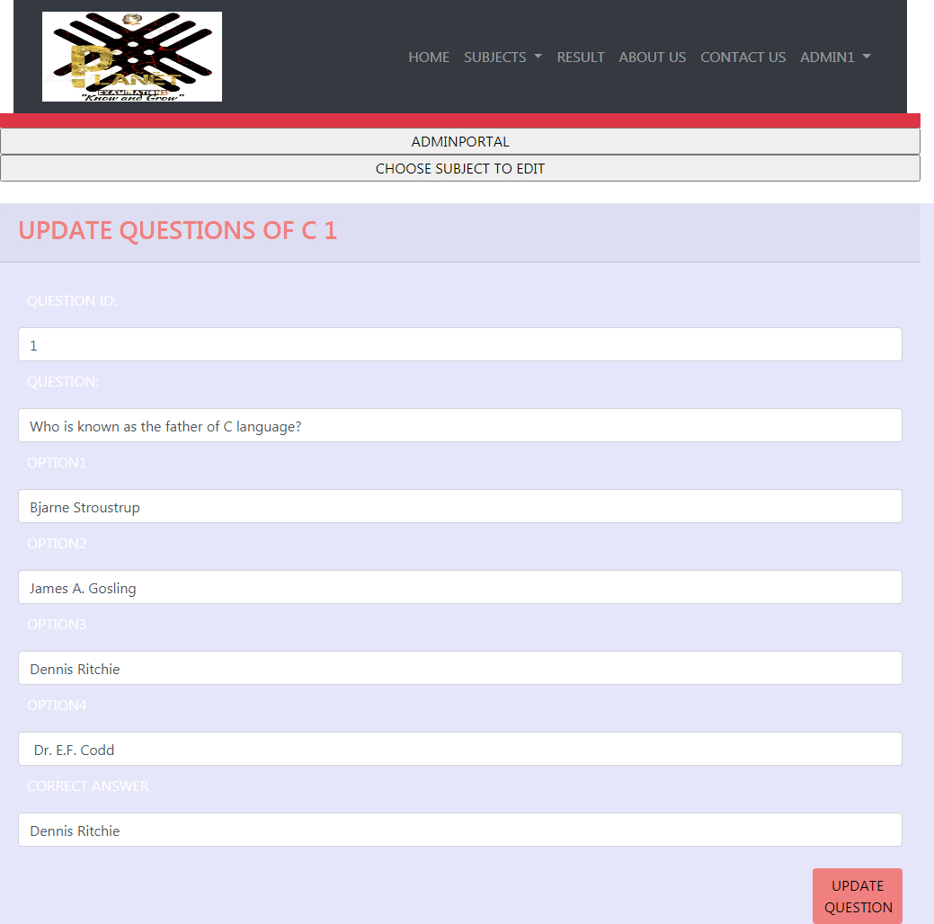
AREA OF THE PROJECT (ADMIN)
UPDATE OF NEW QUESTIONS :-

Slide 32

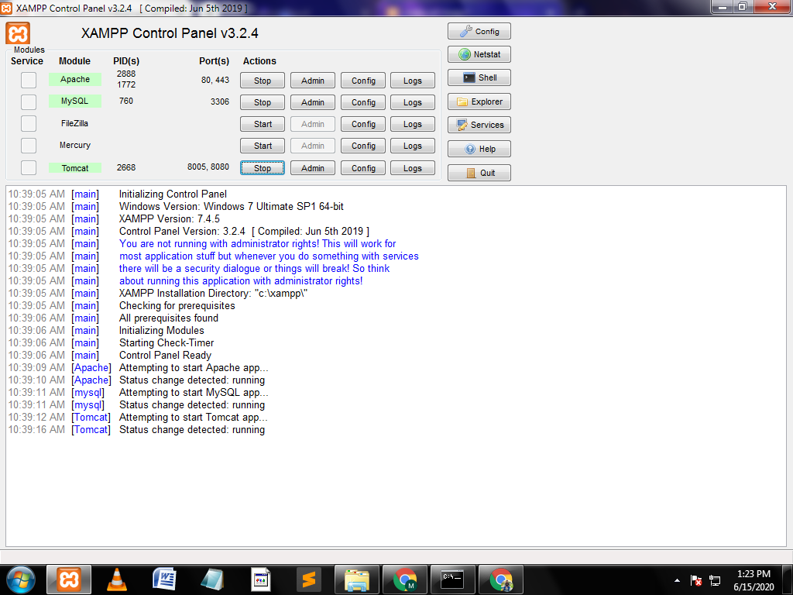
AREA OF THE PROJECT
XAMPP CONTROL PANEL:-

Slide 33
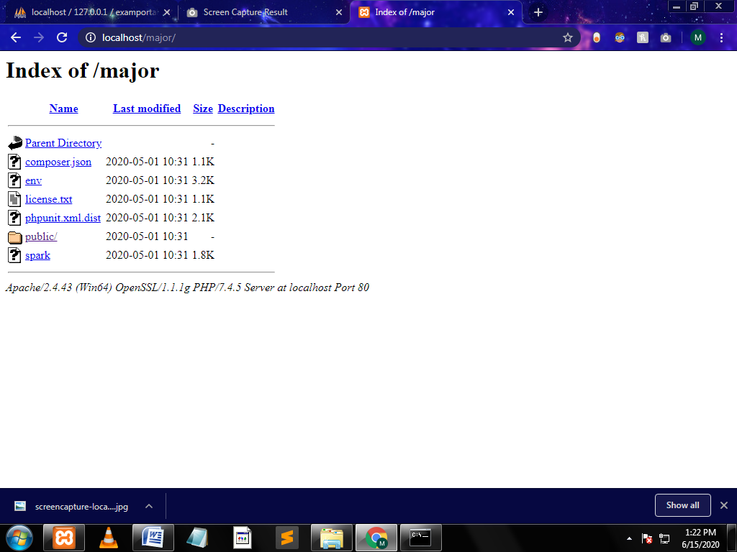
AREA OF THE PROJECT
INDEX:-

Slide 34
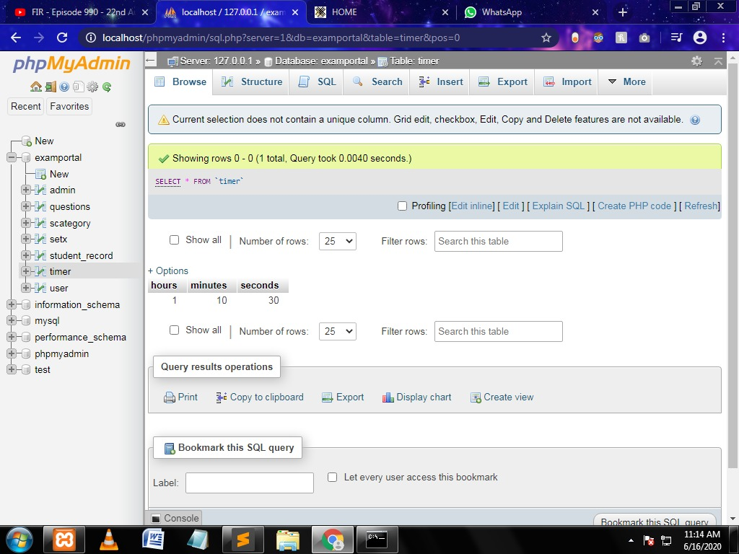
DATABASE SNAPSHOT

Slide 35
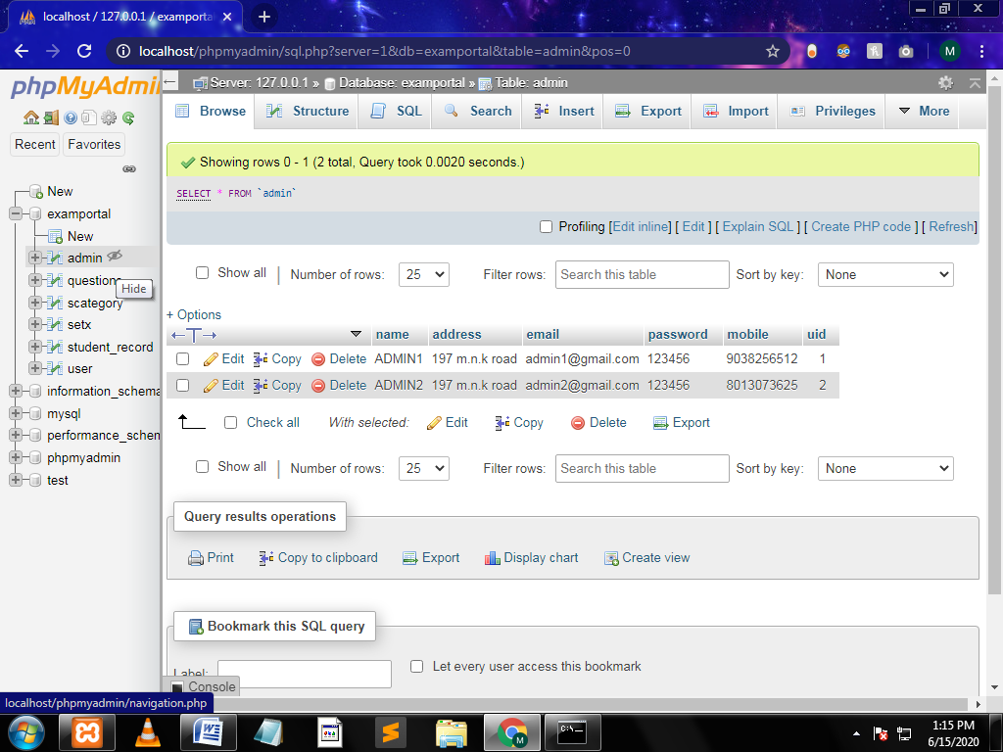
DATABASE SNAPSHOTS

Slide 36
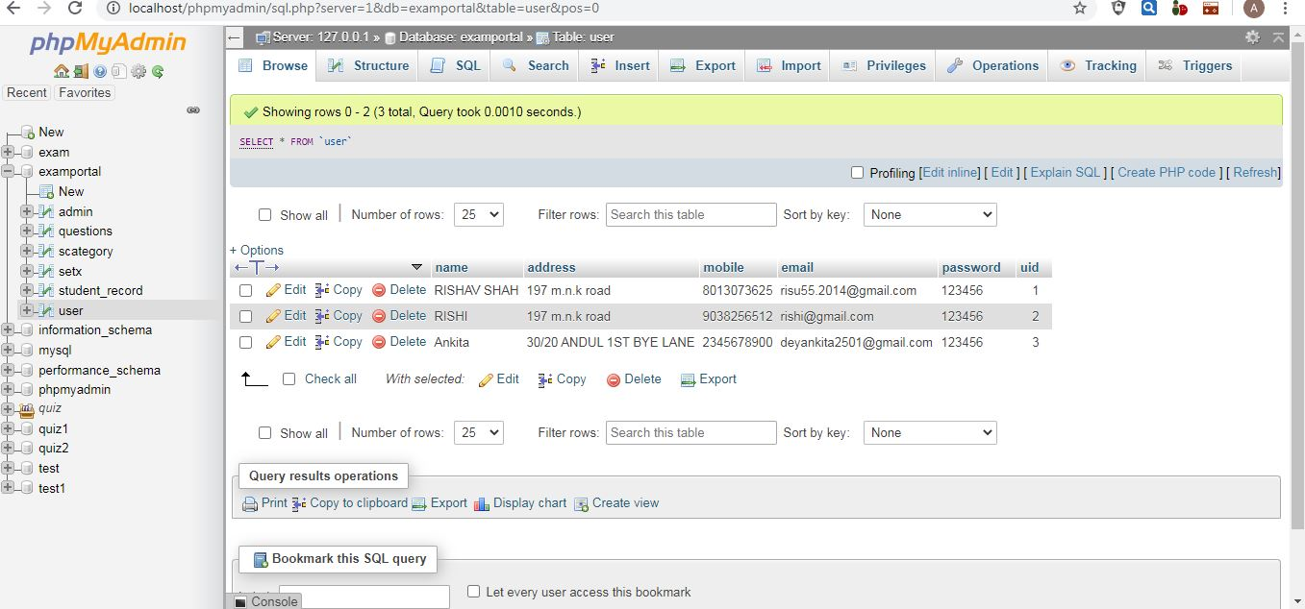
DATABASE SNAPSHOTS

Slide 37

Future scope:-
The project has a very vast scope in future. We can provide more attractive features and update it as our requirement arises, as it is very flexible in terms of expansion, for development following can be done:-
We can give more advance programs in including more facilities like reminder of different examination.
Including the mocks, lessons and notices whose pdf will be available at the website.
We will host the platform for online server to make it accessible worldwide.
The website is not accessible to everyone. it can be deployed on a web server so that everyone can access it.
As of now only 5 to 6 types of exams are available ,in future more subjects with many concepts will be there.
A feedback page will be provided in which user can post their reviews.
Addition of valuable questions and various topics will also be added.
We are also going to intake Governmental examinations in a year.

Slide 38

“conclusion”
The website provides a online mode of a Examination, which enables the Students to read online pdfs and give online test which reduces much effort, money and travel. The Students can choose the exams by their own or given by respective companies or their schools and collages. They can search for exams on some selective subjects to test their knowledge and efficiency, their is also a specific time limit to complete the examination to know about their own speed. The result of the exam is given then and there, thus making the process of examination much more hassle-free and easier.

Slide 39

bibliography
www.W3schools.com
www.getbootstrap.com
www.apachefriends.org
www.Wikipedia.com
www.Google.com
www.Youtube.com
www.Spoken-tutorial.org
book references:-
PHP and mysql web development by Luke welling and Laura Thomas.
Html and CSS: Design and Build Websites by Jon Dukett.

Slide 40
Thank you....

